Slide 1
Introduction to Proposed Zoning Regulation Changes
PLANNING + ZONING COMMISSION MEETING
November 19, 2024
Addition of: New General Commercial and Residential Zones
Changes to: Parking and Loading Regulations
"C:\Users\creanel\Desktop\2024 WORKING DOCUMENTS REG UPDATE\ACTIVE\Introduction to DRAFT Regulations 11122024 LC+PK.pptx"
Notes:
Paul to make introduction

Slide 2
MEETING AGENDA November 19, 2024
Review Proposed Changes, Background and Rationale
Receive Written Questions from Public
Answer Questions
Notes:
Paul K

Slide 3
Do you have your index card and a pen?
Is this session being recorded and will it be available online?
YES and YES
Will the public have another opportunity to speak?
YES, the public will be able to speak at the public hearing for the Text Amendment and the Map Amendment applications.
Who votes on these regulations?
The Planning and Zoning Commission is the only body legally empowered to vote on our Zoning Regulations
Notes:
Paul K

Slide 4
Topics of Discussion
THE LIMITS OF ZONING
HOUSING NEED
WORKFORCE EXPANSION
THAMES STREET STUDY RECOMMENDATIONS
PROPOSED ZONING MAP CHANGES AND DENSITY
ALLOWED USE TABLE
PARKING
POCD PRINCIPLES: HOW THE ENTIRE CITY BENEFITS FROM IMPLEMENTING THESE PLANNING PRINCIPLES
DIMENSIONAL STANDARDS AND RENDERINGS
Notes:
Paul K.

Slide 5
What can zoning do?
ZONING CAN Regulate
Building height
Lot coverage
Non-public parking
Location
Maximum and Minimum
Pervious vs. impervious areas
Landscape standards
Exterior lighting standards
Signage
Where a building and parking can be located on a lot
Uses
Form
Trash location
…and more
Notes:
Paul/Leslie

Slide 6
What zoning can’t do.
ZONING CAN’T Regulate
Behavior (Police)
Noise (Police)
Building color (Historic Districts)
Architectural style (Historic Districts)
Housing decisions based on the effect of the number of children entering a school system (illegal in CT)
The ethnic, religion, gender identity, race or other protected classes of tenants or property owners (illegal in CT)
Speed, parking and traffic direction on PUBLIC roadways (Police)
Notes:
Paul/Leslie

Slide 7
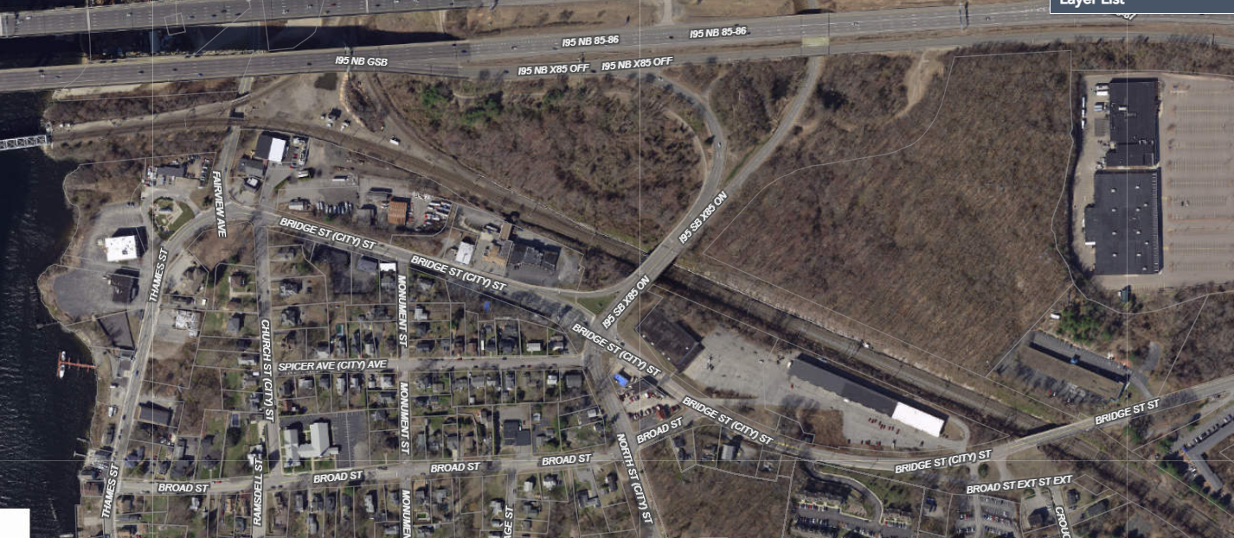
2020 Aerial Map for Reference
Notes:
Paul

Slide 8

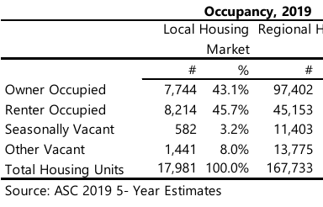
Housing Needs
Town of Groton Housing Studies 2021 and 2023
Town of Groton – Office of Planning and Development Services
Camoin Associates
2021 Study – Groton Housing Supply (2019)
Notes:
Paul

Slide 9
Housing Needs
2021 Study
Estimated 10-year potential housing demand 5,260 Units
40% owner occupied (2,104)
60% rental (3,156)
Demand Drivers
Local workforce hiring
Capturing commuters
Pent-up demand
Smaller household size
Proximity to major employers
Challenges
Lack of readily developable land/sites
Quality of place
Notes:
PAUL
Local workforce hiring
Capturing local workers living in other communities
Pent-up demand for modern upscale apartment units in the region
Trend toward smaller household size due to aging population
Immediate proximity to major employers provides a unique competitive advantage for Groton to absorb a significant portion of future housing demand and the associated economic benefits (“Retail follows rooftops”)
Lack of readily developable land/sites poses a challenge
Quality of place is a competitive disadvantage

Slide 10
Housing Needs
2023 Update
Estimated 10-year potential housing demand 6,450 Units
23% increase
40% owner occupied (2,580); 60% rental (3,870)
What Changed - 2021 Drivers remain in place
Stronger than anticipated economic growth
The region is expected to add over 2,200 households
The price of single-family homes has escalated significantly
Housing construction has not kept pace with demand
Apartment vacancy rate dropped to 2.3% in 2023
Increase in empty nesters
Land is limited
Notes:
PAUL
Stronger than anticipated economic growth indicates over 6,250 new jobs will be created through 2031
The greater region is growing and is expected to add over 2,200 households over the next decade representing 14% growth overall
The price of single-family homes has escalated significantly which has driven increased demand for rentals
Housing construction has not kept pace with demand
The apartment vacancy rate has dropped to an extremely low 2.3% in 2023 indicating virtually no availability of rental units
Increase in empty nesters and seniors many of whom don’t want or can’t live in single-family homes any longer but don’t have alternative options in Groton due to the lack of rental units
Land is a limited commodity, and multifamily building is a more efficient use of land on a per acre basis and promotes conservation of open space

Slide 11
The Opportunity
Leverage Growth in Housing Demand to Revitalize Thames Street
Local employment growth
Expected 23% increase over 5 years
EB is not the only growth driver, but it is the largest
Columbia class submarines
Estimate 0.9 indirect jobs created for every direct EB job
Regional economic growth will drive sustained housing demand
How: Implement Thames Street Study Recommendations (Aug 2019)
Denser development at Upper Thames Street / Bridge Street (p11)
Topography
Parcel sizes
Limited flood zone issues
Zoning Changes Needed to Encourage Development (p25)
Allow Multi-Family Housing (p25)
Reduce Parking Requirements (p26)
Add Design Considerations (p26)
Notes:
PAUL
EB projects Groton employment growth from 8,850 in 2024 to 10,900 in 2029*
This represents a 23% increase over 5 years
EB expects 0.9 indirect jobs will be created for every direct EB job, adding another 1,845 jobs by 2029
Columbia class submarines are the Navy’s highest construction priority
EB is not the only growth driver, but it is the largest
Regional economic growth will drive sustained housing demand
Concentrate denser development at Upper Thames Street / Bridge Street to take advantage of the topography, parcel sizes and limited flood zone issues (p11)
To Encourage Development, Zoning Changes Need to be Considered (p25)
Allow Multi-Family Housing (p25)
Reduce Parking Requirements (p26)
Add Design Considerations (p26)

Slide 12
Thames Street Study Background
Ninigret Partners (NP) hired to prepare a redevelopment analysis and plan for the Thames Street/Bridge Street area of Groton
Multi-step Process
Site Visits
Stakeholder Interviews
City Officials, Business and Property Owners, Community Members
City Plan of Conservation and Development (POCD)
Identifies Thames Street as a primary area for investment
Public Workshop and Online Survey
Community Priorities and Concerns
Report issued Aug 27, 2019
Notes:
The NP team used an iterative process to develop this plan, collecting primary and secondary research through a variety of means, interviewing stakeholders, holding a open-house public workshop and conducting an online survey. The NP team conducted primary research by visiting the study areas to observe the physical conditions and characteristics.
NP conducted interviews with key stakeholders from the community, in order to understand what the community’s priorities were and what they perceived the major issues to be. Interviewees included local officials, business and property owners and community members.
As part of the research process, NP referred to the City of Groton’s Plan of Conservation and Development (POCD), which identifies the Thames Street Action Area as a primary area for investment. The plan outlines several strategies to strengthen and enhance Thames Street.
The primary research was then supplemented with secondary research, as the team reviewed census data, real estate market data, etc.
Finally, an open house-style public workshop and online

Slide 13
Thames Street Study Recommendations
Maximize Walkable Historic Coastal Village Feel
Enhance the Waterfront
Create a Buffer Around EB
Concentrate Denser Development at Upper Thames Street / Bridge Street Area To Create Mixed Use Gateway
Consistent with Current POCD

Slide 14
Thames Street Study Recommendations
Concentrate Denser Development at Upper Thames Street / Bridge Street Area To Create Mixed Use Gateway (p34)
WHY:
Relatively Large Parcels
Vacant and/or Underutilized
Topography
HOW: Three major changes needed (p38)
Change designated use
Decrease parking requirements
Modify current multi-family standards
Notes:
Relatively Large Parcels
Vacant and Underutilized
Topography allows taller buildings without obstructing view corridors
Change in designated use - Changing the parcels’ General Commercial zoning designation, which does not allow residential uses.
Decrease parking requirements for multifamily units in order to optimize available developable land.
Modify current multi-family standards, which do not support mid-density development as envisioned for the site.

Slide 15
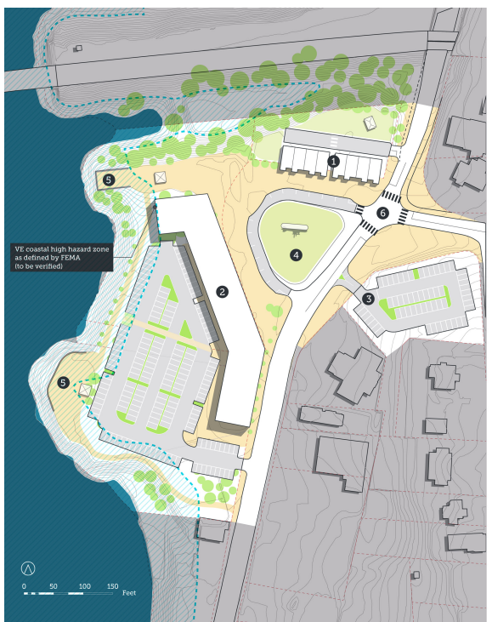
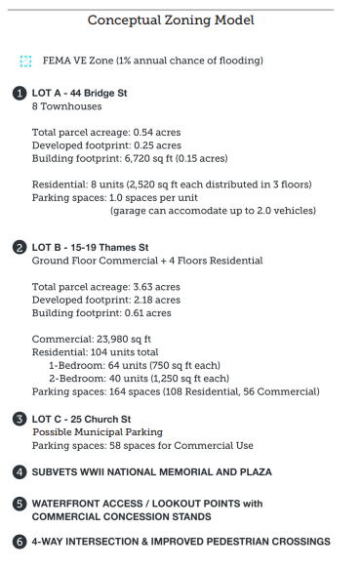
Thames Street Study Conceptual Development Plan – GCR Zone (adapted p36)
Notes:
Bob Boris

Slide 16
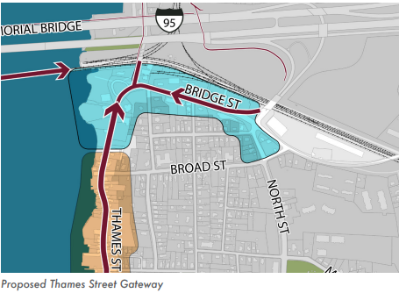
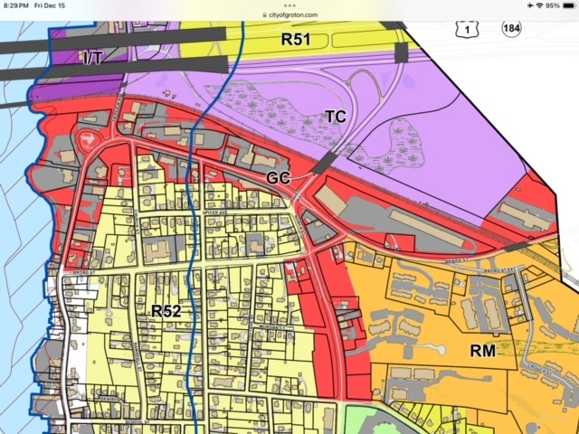
Where are we talking about? Location of denser development
Proposed Tames Street Gateway
Current General Commercial Zone
Notes:
Jason R

Slide 17
2020 Aerial Map for Reference
Notes:
Paul

Slide 18
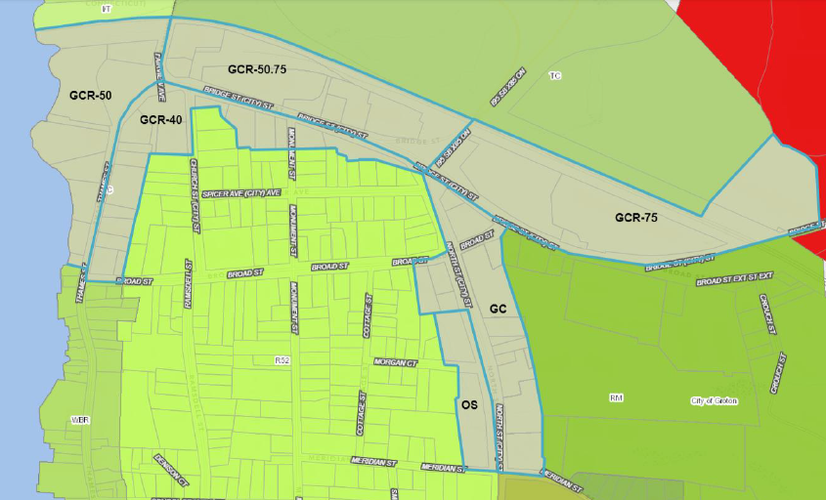
Notes:
Jason R

Slide 19
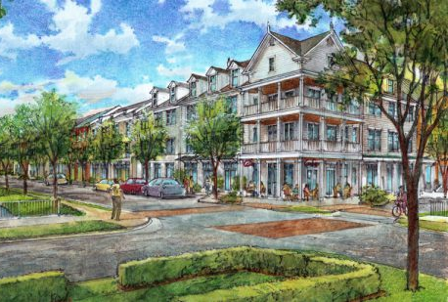
New Zones – Height Limits
Notes:
Leslie

Slide 20
New Zones – Housing Density
Notes:
Jason R

Slide 21
How to Read the Use and Permitting Table
This is an exhaustive list, any use not listed is not permitted.
Each row has a permitted, or not permitted, use listed on the far left. Each column is a specific zone.
In the columns going Left to Right, GC, GCR-40, GCR-50, GCR-50.75, and GCR-75
Each row has a heading in a dark blue box with white lettering, that is the category of use. In other places in the regs categories are mentioned. (such as in parking)
Notes:
Cameron J

Slide 22
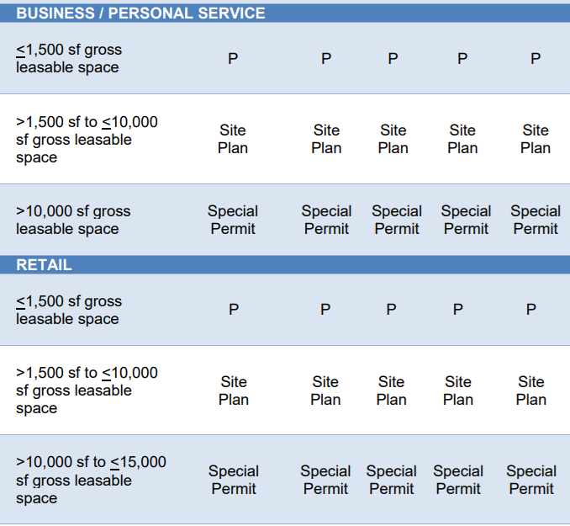
How to Read the Use and Permitting Table
GC | GCR 40 | GCR 50 | GCR 50.75 | GCR 75
Category of Use
Required Permits
Listed per use, per zone
The Use
“P” means “Permitted by Right”
“X” means
“Not Permitted”
Notes:
Cameron J

Slide 23
What are the Different Permit Requirements?
By Right
Uses permitted by right and do not require review by either the City Planner or the Planning and Zoning Commission.
Site Plan
A Site Plan requires an application, and a detailed survey that must be reviewed by the City Planner and Planning and Zoning Commission and must be approved by the Planning and Zoning Commission.
Special Permit
A Special Permit is similar to Site Plan; it requires a detailed survey, an application, and must be approved by the Commission. It requires a detailed presentation and review of the scope of use(s) and a Public Hearing.
Notes:
Cameron J

Slide 24
How did We Make the Table?
Consideration of current, past, and possible uses, physical, site and form of the zone, and traffic & parking constraints
Avoidance of Non-conformity
Vehicle Dealership
Light Manufacturing
Promotion of consistency that works with the location
When we are talking about uses and when we are talking about footprint
Notes:
Cameron J
Talk about the primary goals that the graph achieves.
What were the important conversations every time the chart came up?
Parking requirements and access
How large the building might be, what are average building sizes
How does that use effect traffic and sightlines in that area
Is that use permitted anywhere else? Does that use already exist in any zone?
The store across from the distillery is, by definition, a car dealership. So we allowed it within the zone as a special permit to keep it in conformity.
The sailmaker on thames street is, by definition, a light manufacturer. We had to keep that use in conformity. Additionally, Light Manufacturing is a broad definition that includes many similar uses to “sailmaking” which is quiet and low impact. We wanted to leave the door open for similarly quiet and low impact business operations.
Retail, office, and assembly spaces use identical permit requirements. The view is that what occurs inside the building has little impact on the design of the exterior. A 3,000 square foot office building will have a nearly identical footprint to a 3,000 square foot retail store. In an effort to stay consistent it was important to us that, for uses only, we consider footprint over nitpicking smaller uses.

Slide 25
Parking and Transportation
New Section added for Parking and Loading (Section 7.2) specifically for GC and GCR for the following reasons:
Simplifying the existing regulations
Facilitating the goals of the Plan of Conservation

Slide 26





Parking and Transportation (Sec 7.2)
Section 7.2 supports the following in line with the POCD:
Safe transportation
Human-scale development
Live-work-play development
Mixed transportation mode choices
Including healthy, active transportation choices
Protecting public and residential viewsheds

Slide 27
Parking and Transportation (Sec 7.2)
Updates to Current Code:
Maximum drive aisle widths, turning radiuses, and curb cuts
Parking location requirements
Shared Parking Factor
Buffer requirements
Bicycle parking accommodation
Goals:
Safe transportation
Human-scale development
Live-work-play development (mixed-use)
Mixed transportation mode choices
Including healthy, active transportation choices
Protecting public and residential viewsheds

Slide 28
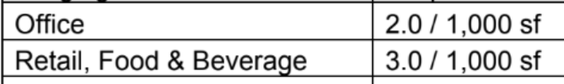
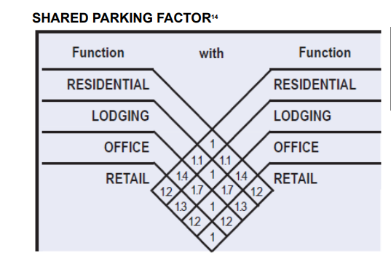
Shared Parking Factor* – CT Best Practice
*The images and diagrams appearing in SmartCode Version 9.2 are the property of Duany Plater-Zyberk & Company (DPZ). Their reproduction and use is freely permitted.
Dentist Office (1,000 sf): 2 parking spaces required
Restaurant (2,750 sf): 8.25 ➔ 8 parking spaces required
10 parking spaces TOTAL before shared parking factor is applied
Shared Parking Factor (See green box table): 1.2
Total spaces required: 10 / 1.2 = 8.3 ➔ 8 motor vehicle spaces
20% reduction
Bicycle Parking Requirements: 8/ 10 = 0.8 ➔ 1 bicycle space

Slide 29
Continue to…
Public Investment / Actions
6. Upgrade the physical environment of Thames Street (paving, sidewalks and streetscape.
7. Use “tax increment financing” as a way to pay for public investments that will spur appropriate private development.
8. Address future parking needs.
9. Seek opportunities to create a public boardwalk along the Thames River, north of Electric Boat.
10. Seek simplifying traffic circulation on Thames Steet and deter truck traffic (except local deliveries).
Private Investment / Development
4. Promote development that contributes to the overall vision for the Thames Street area and is consistent with the historic character and scale.
5. Encourage or require private development to interconnect parking areas behind buildings and underneath building on the down hill side of Thames Street.
Design a Physical Main Street Neighborhood
Strengthen the vibrant mixed-use of the Thames Street Area.
Maintain and enhance the “sense of place” along Thames Street including…design guidelines.
Plan for the Thames Street area (including regionally supported redevelopment) to promote desired outcomes.
Notes:
Leslie

Slide 30
How to create a neighborhood - Principles of good neighborhood design
Neighborhoods and Corridors Best Practices–
Form identifiable areas that encourage residents and property owners to take responsibility for maintenance and evolution
Should be compact, pedestrian friendly and mixed-use
Daily living occurs within walking distance, allowing independence, particularly to the elderly, the young, and differently abled
A broad range of housing types and price levels that serve a range of diverse ages, races, and incomes, allowing a citizenry with a range of skills to build and support personal and civic bonds, essential to authentic community
A range of parks, from tot-lots and parks to waterfront access can define and connect different neighborhoods.
Notes:
Leslie

Slide 31
Great streets make great neighborhoods
KEY CONCEPTS
First mile – Last mile
5-minute walk = ¼ mile
10-minute walk = ½ mile
Elements of Great Streets –
Pedestrian / bike - friendly street design
Buildings close to the street, front porches, windows and doors convey safe spaces
Street trees, on-street parking and awnings protect pedestrians from harsh weather
Parking lots and garages placed behind buildings and houses allow building facades to frame “outdoor rooms” along public streets. This PUBLIC REALM is where great neighborhoods thrive.
Notes:
Leslie

Slide 32
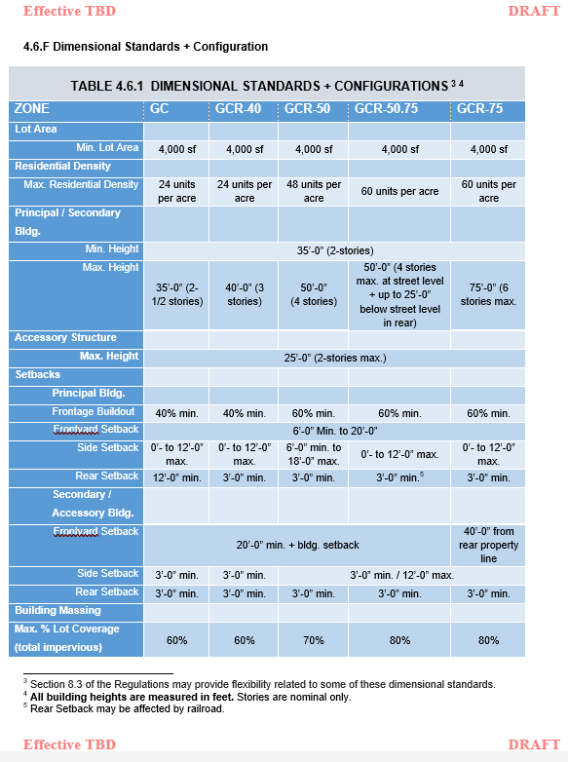
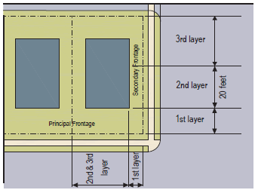
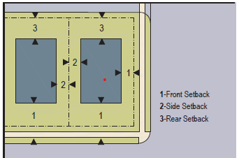
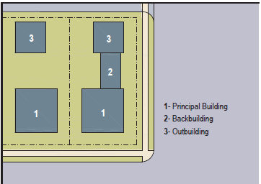
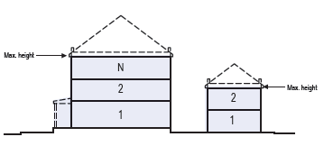
Dimensional Standards + Configurations
Layers
Setbacks
Building Type by Location
Building Height
Notes:
Leslie

Slide 33
Notes:
Leslie

Slide 34
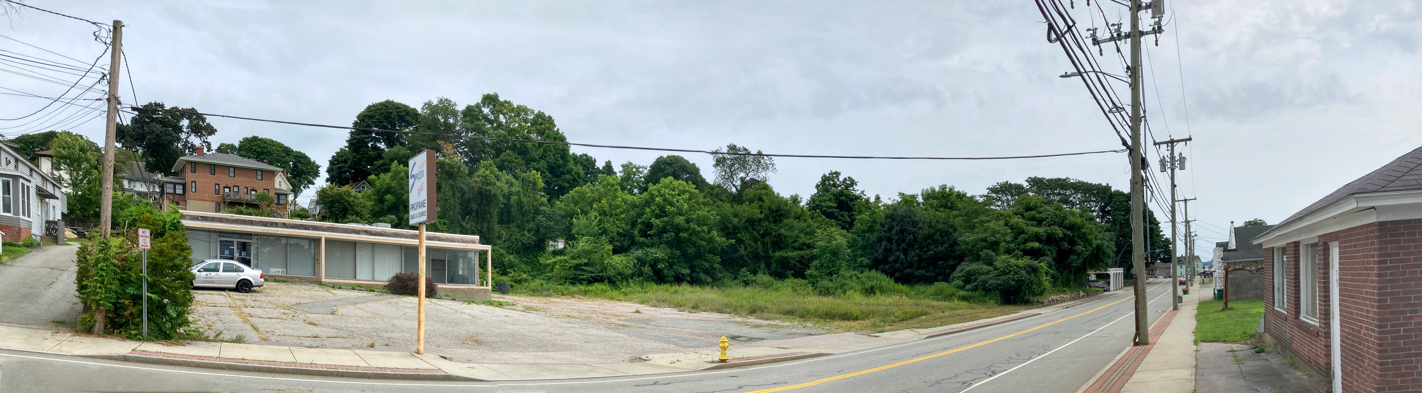
Lots of empty space
Notes:
Leslie

Slide 35
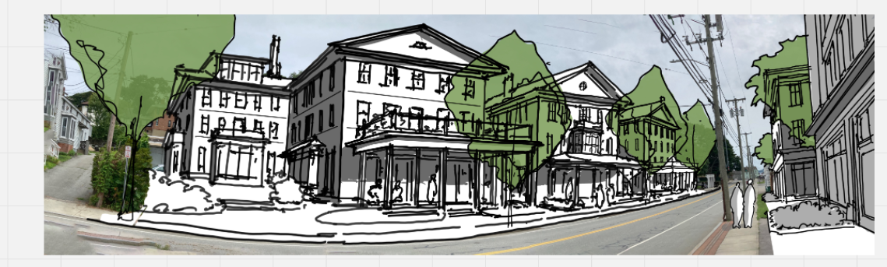
What it could be.

Slide 36
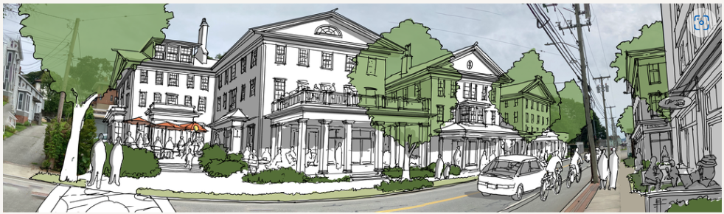
Stay tuned for more improvements!

Slide 37
5 Minute Break Submit Your Written Questions Now
FAQ - reminder
Is this session being recorded and will it be available online?
YES
Will the public have another opportunity to speak?
YES, the public will be able to speak at the public hearing for the Text Amendment and the Map Amendment applications.
Who votes on these regulations?
The Planning and Zoning Commission

Slide 38

QUESTIONS?
Write your questions on an index card and hand them to a member of the Commission.
We will answer as many questions as we can in the next 45 minutes.

Slide 39
Next Steps
Public Informational Meeting: November 19, 2024
PZC authorizes filing of 2 applications:
Text Amendment
Map Amendment
File Map and Text amendment applications with City Clerk
Deliver applications to Southeastern CT Council of Governments for advisory opinion
Post Text and Map Amendment Applications on City website (add website)
Supply hard copy of applications to City Clerk and Bill Memorial Library for public viewing
Post legal advertising in The Day including date and time of public hearings per CGS
Post agenda in Municipal Building Lobby and online
Open and conduct public hearings (hearings may be held simultaneously)
Close public hearings
Commission deliberations on each application
Separate vote on Map and Text amendments that includes:
Confirmation that each application is consistent with the POCD
Establishment of the Adopted Date for each application
Setting of Effective Date for each application
Publish Notice of Decision for each application prior to their effective date
Approved changes become valid on effective date.

Slide 40
Thank you To the public who attended meetings, workshops and hearings, who sent emails, met with staff, and passed along concerns, ideas and photos over the past several months
Paul Kunkemoeller, Chair
Susan Bergeron, Secretary
Robert Boris, Vice-Chair
Jason Rusk
Coleen Lautrup
Cameron James
Colton Jenkins (Absent)
Leslie Creane, AICP
City Planner
Cierra Patrick
Economic Development Manager

